Slide 1
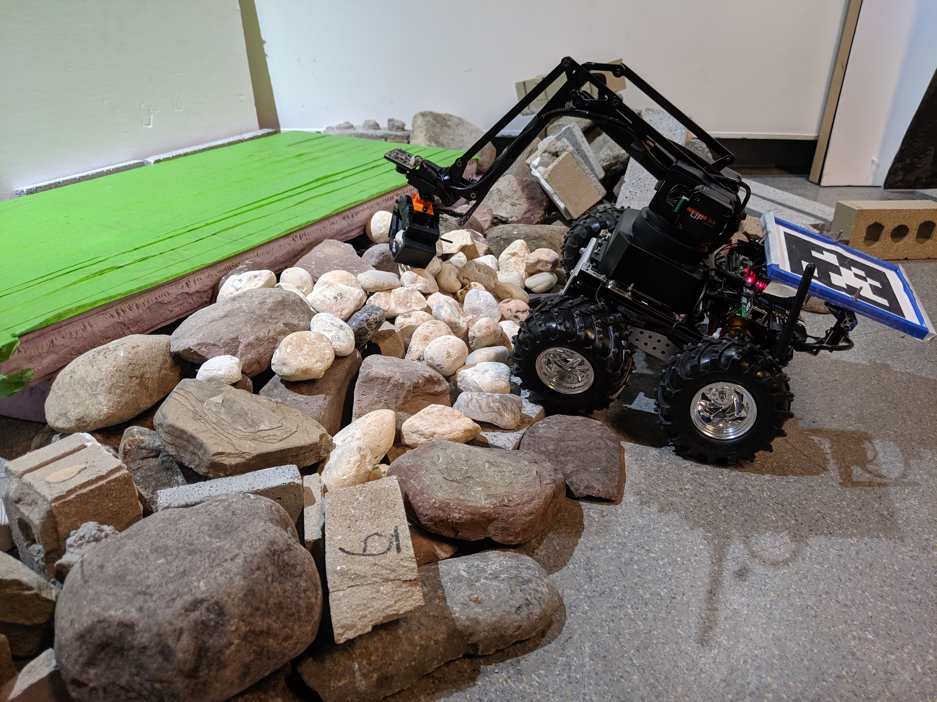
Performances of AprilTag and Intel Realsense Tracking Camera T265
Group: return True
Jiwon Choi (jiwoncho@buffalo.edu)

Slide 2

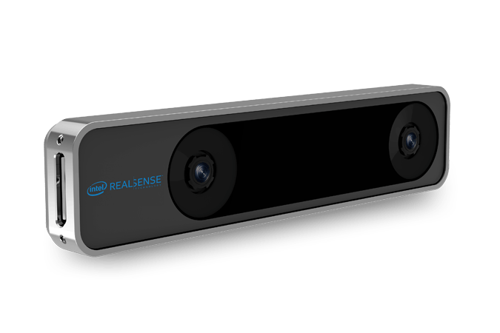
Motivation
AprilTags are time-consuming.
Trying to improve the system with the Intel Tracking Camera T265.
If it turns out to be better, then we will be using the camera.
They will be attached to the four-wheeled robot, and will be analyzed based on the positions that they get.
Fig. 1: AprilTag
Fig. 2: Intel Realsense Tracking Camera T265

Slide 3
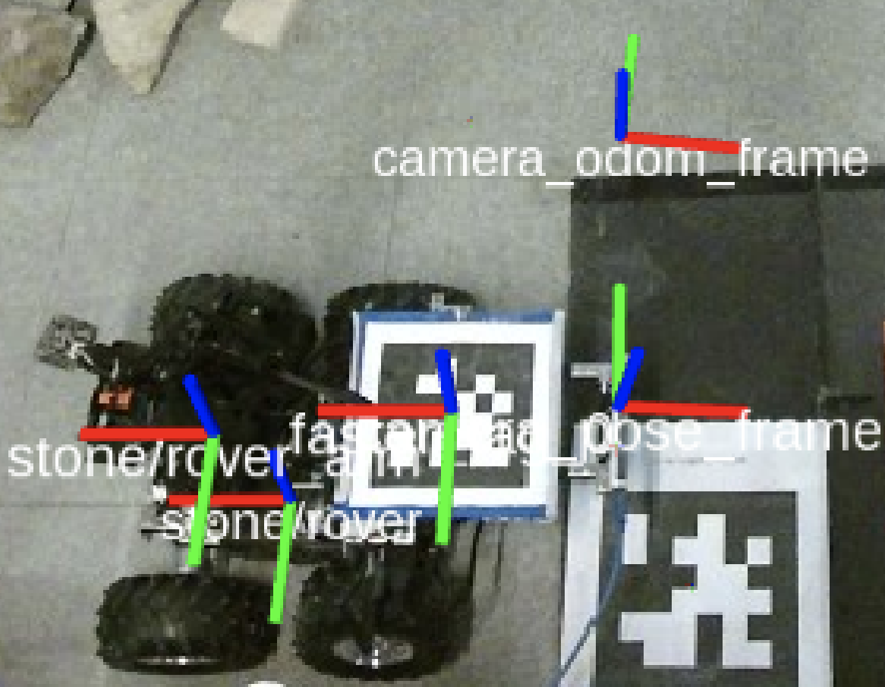
Challenges
Visualization of the data acquired.
Data is acquired thru transform from the initial position frame to the:
AprilTag
Current Position of the Camera
Comparison of the datasets that have an offset distance between the center of the AprilTag and the camera.
Fig. 3: Different center positions of the AprilTag and the camera. The offset is approximately 12.5674 cm.

Slide 4
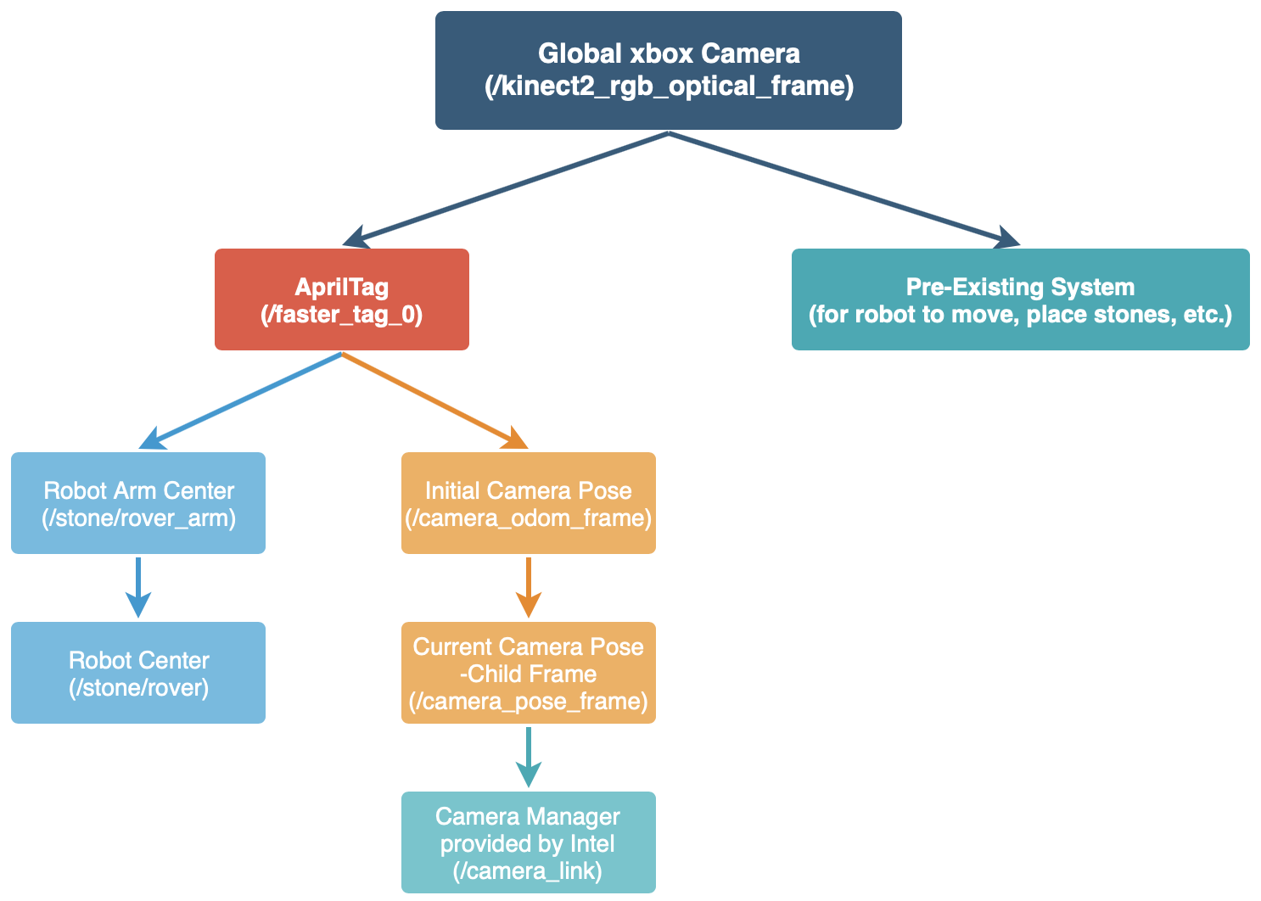
System Overview
Connect existing system with the camera TF.
/camera_odom_frame getting the AprilTag position only once at the start
TF Listener from /camera_odom_frame to the AprilTag and /camera_pose_frame

Slide 5
Analysis: Data Collected
Smooth Terrain, with Straight Robot Movement
Rugged Terrain, with Straight Robot Movement
Smooth Terrain, with Random Robot Movement
Rugged Terrain, with Random Robot Movement
*Note: The position between the AprilTag and the camera has an offset of approximate 12 cm.
*Note2: In movement, the linear velocity = 0.09 and the angular velocity = 0.5

Slide 6
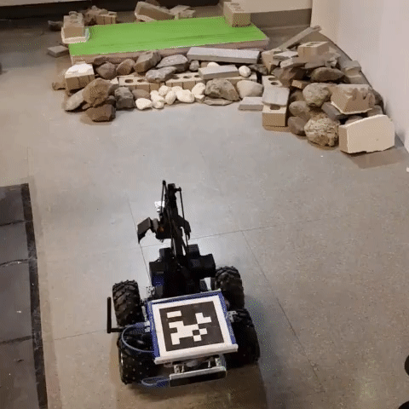
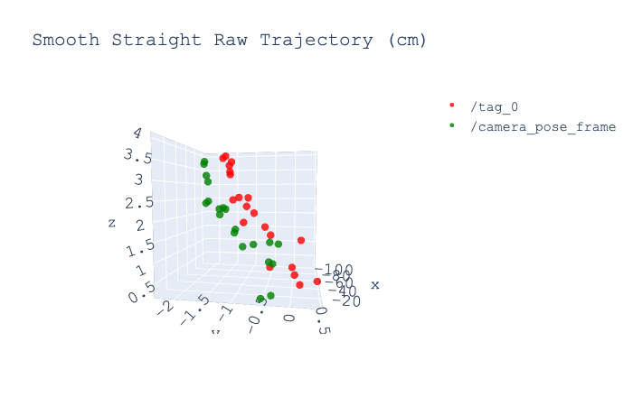
1. Smooth Straight Raw Trajectory
x20

Slide 7
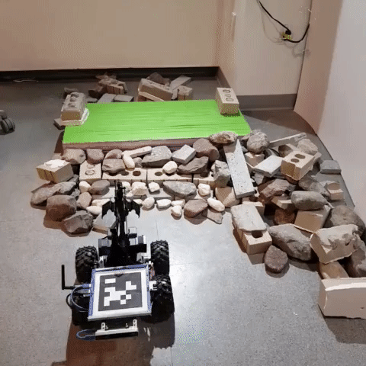
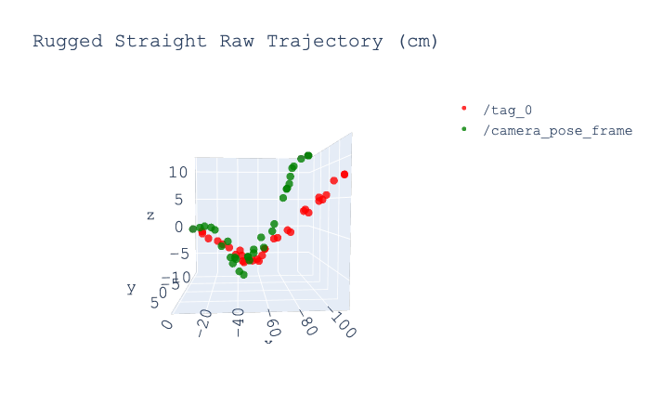
2. Rugged Straight Raw Trajectory
x20

Slide 8
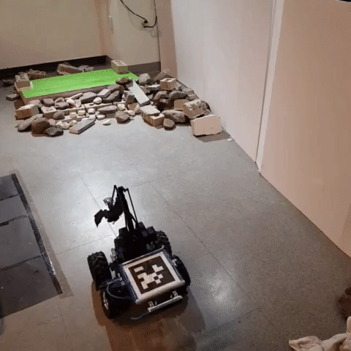
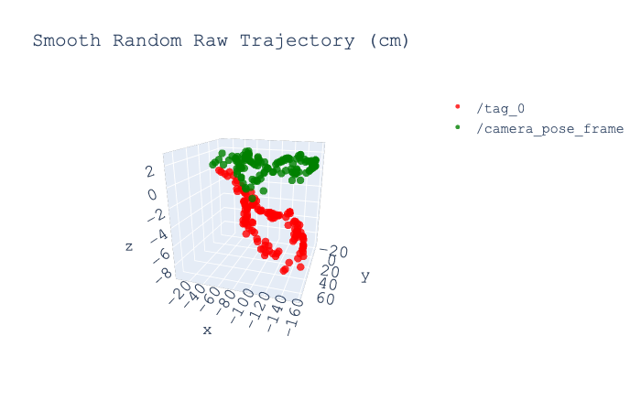
3. Smooth Random Raw Trajectory
x20

Slide 9
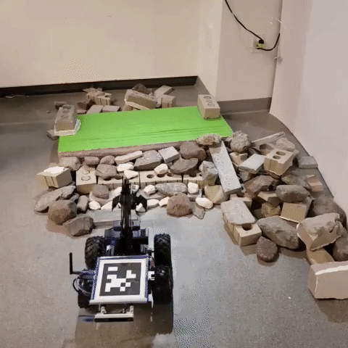
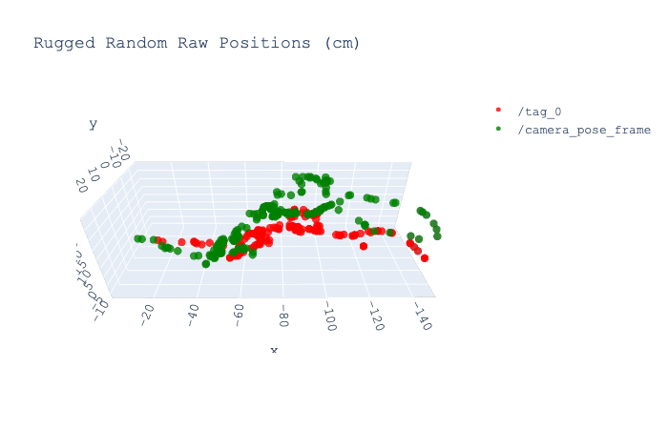
4. Rugged Random Raw Trajectory
x20

Slide 10
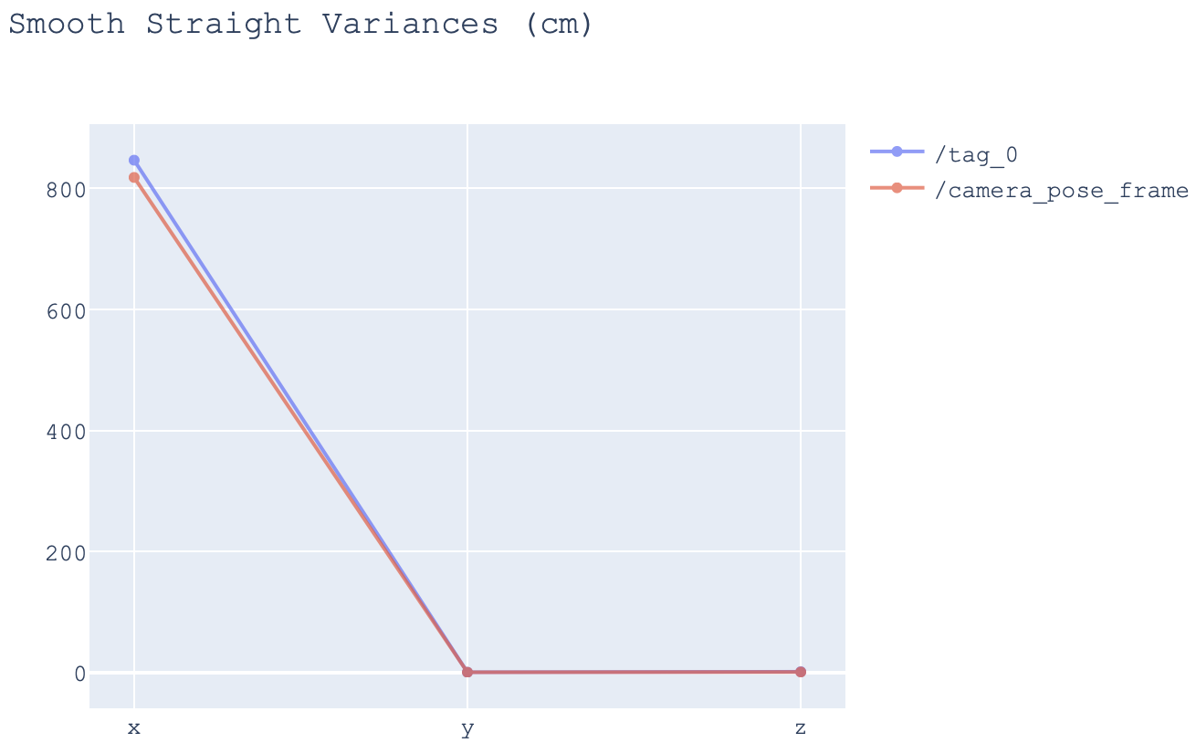

Variance of Positions: Straight Movements
Data should be proportional regardless of the offset.
The more the varies, the more the coordinates/positions has collected.
Notes:
Even if there is a difference between the center of the AprilTag and that of camera, the data should be proportional. Since I was moving around the robot while acquiring the data, the more the varies, the more the coordinates has collected.

Slide 11
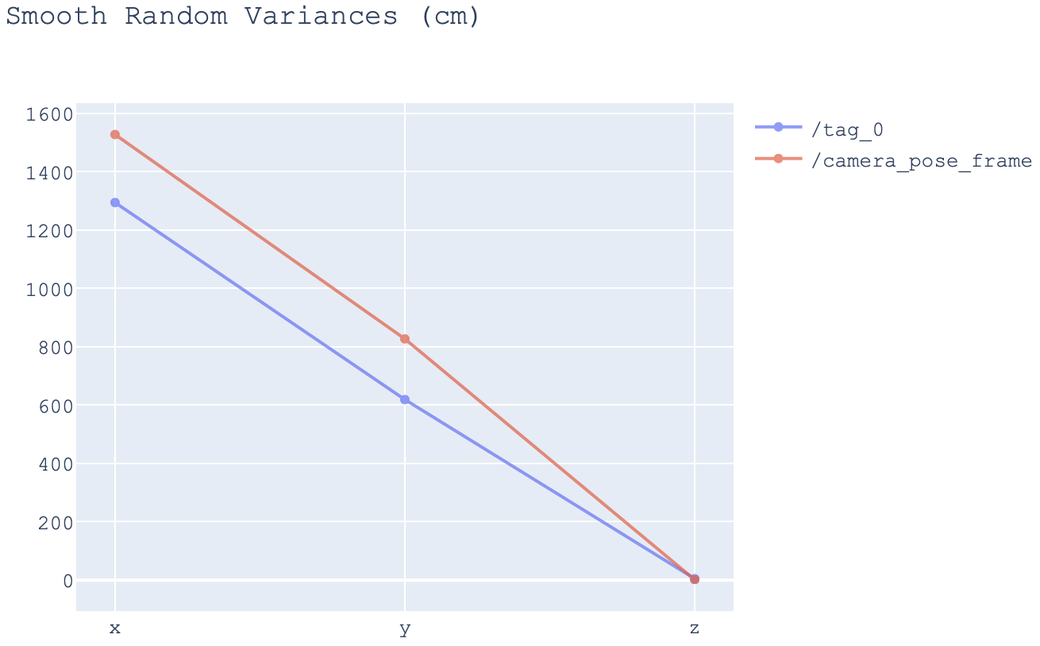
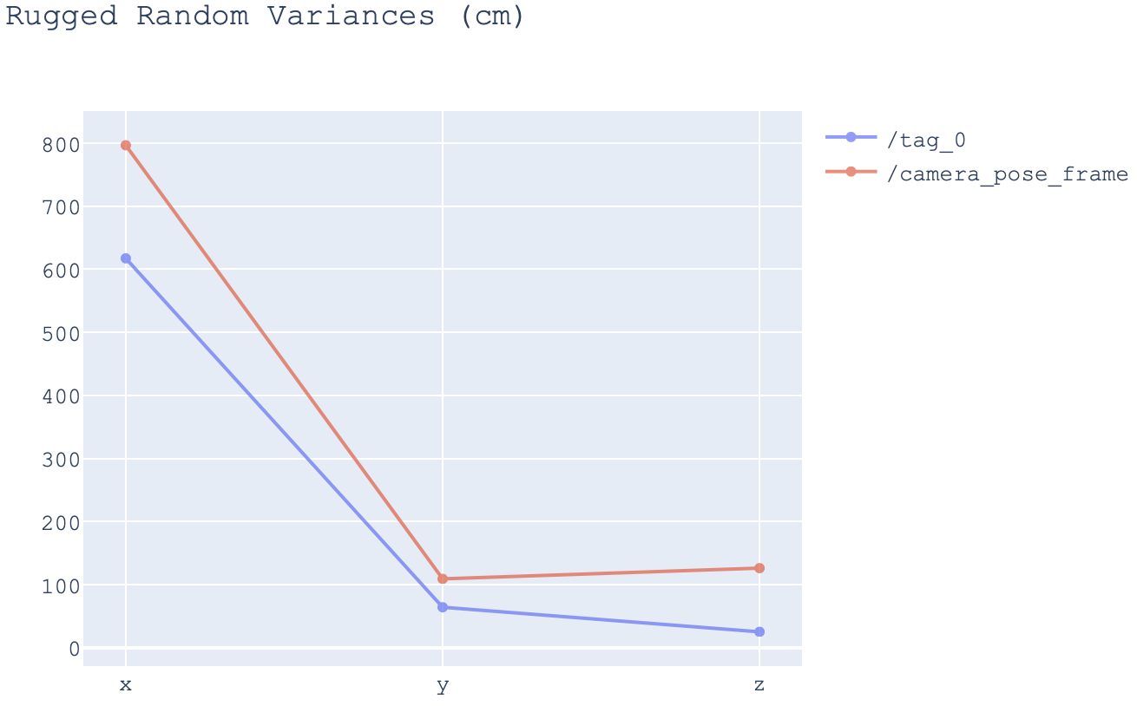
Variance of Positions: Random Movements
Data should be proportional regardless of the offset.
The more the varies, the more the coordinates/positions has collected.
Notes:
Even if there is a difference between the center of the AprilTag and that of camera, the data should be proportional. Since I was moving around the robot while acquiring the data, the more the varies, the more the coordinates has collected.

Slide 12
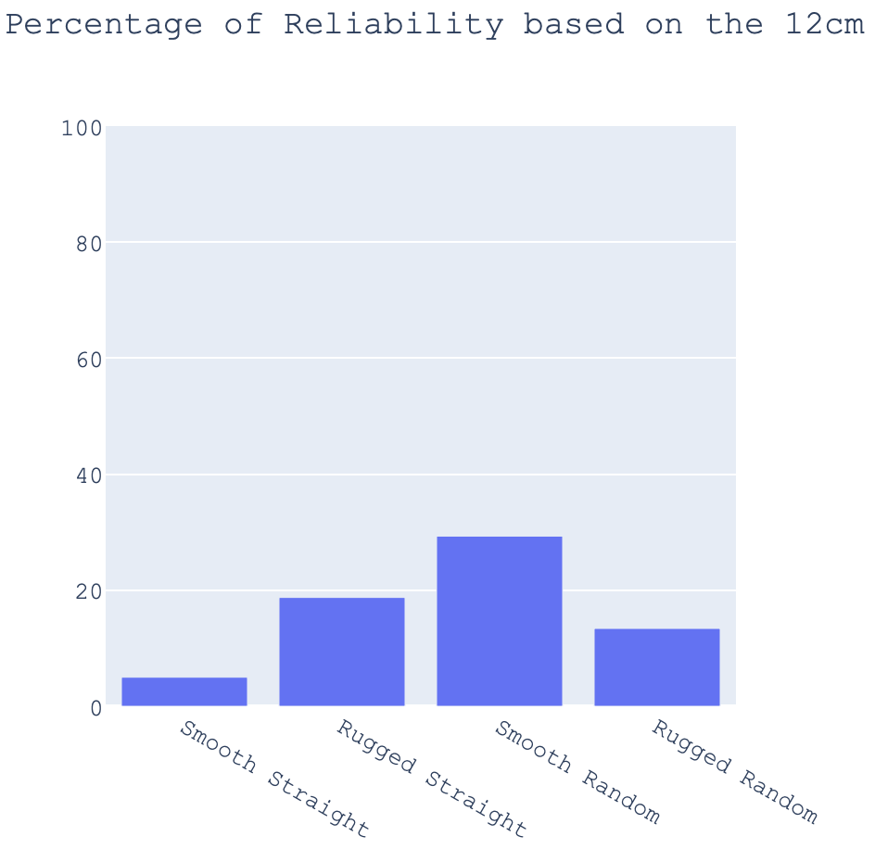
Euclidean Distance: % within Error bound
If the Euclidean distance is within 12.5674 $±$ 0.5cm, it means that the data that we get from both Tag and camera have discrepancies in between.

Slide 13
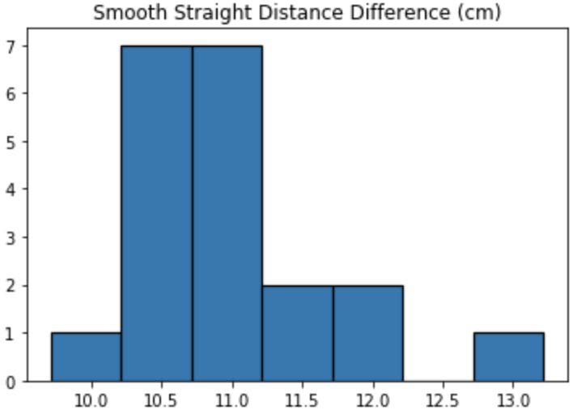
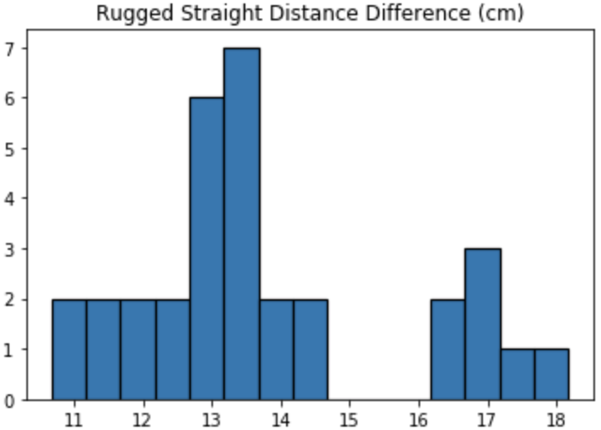
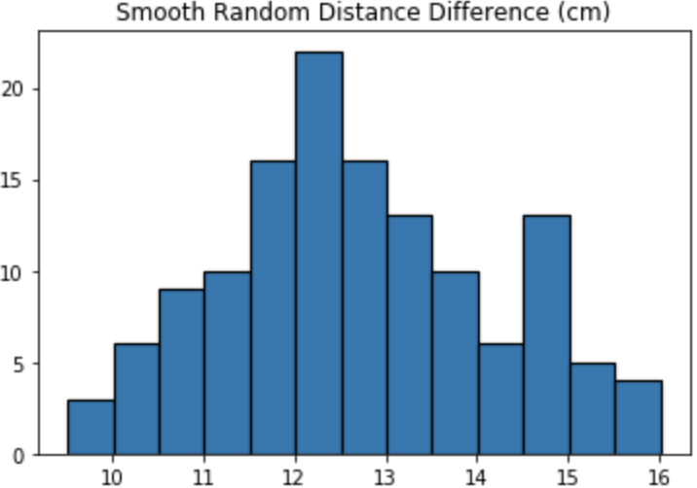
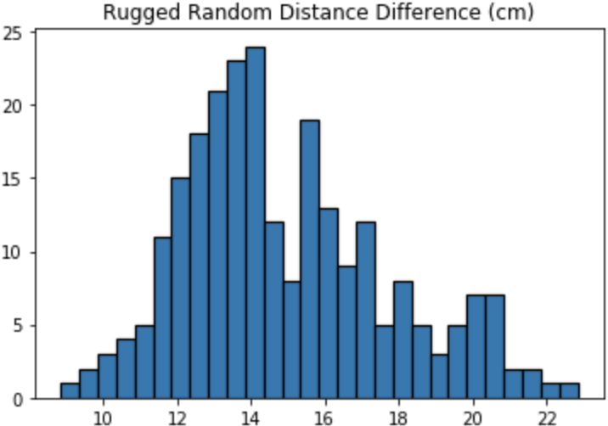
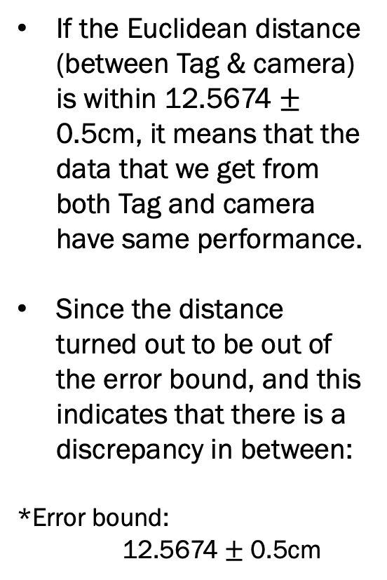
Euclidean Distance: Histogram per Dataset
If the Euclidean distance (between Tag & camera) is within 12.5674 $±$ 0.5cm, it means that the data that we get from both Tag and camera have same performance.
Since the distance turned out to be out of the error bound, and this indicates that there is a discrepancy in between:
*Error bound:
12.5674 $±$ 0.5cm
Notes:
Since the distance above turned out to be out of the error bound, we will take a look how different are they.

Slide 14
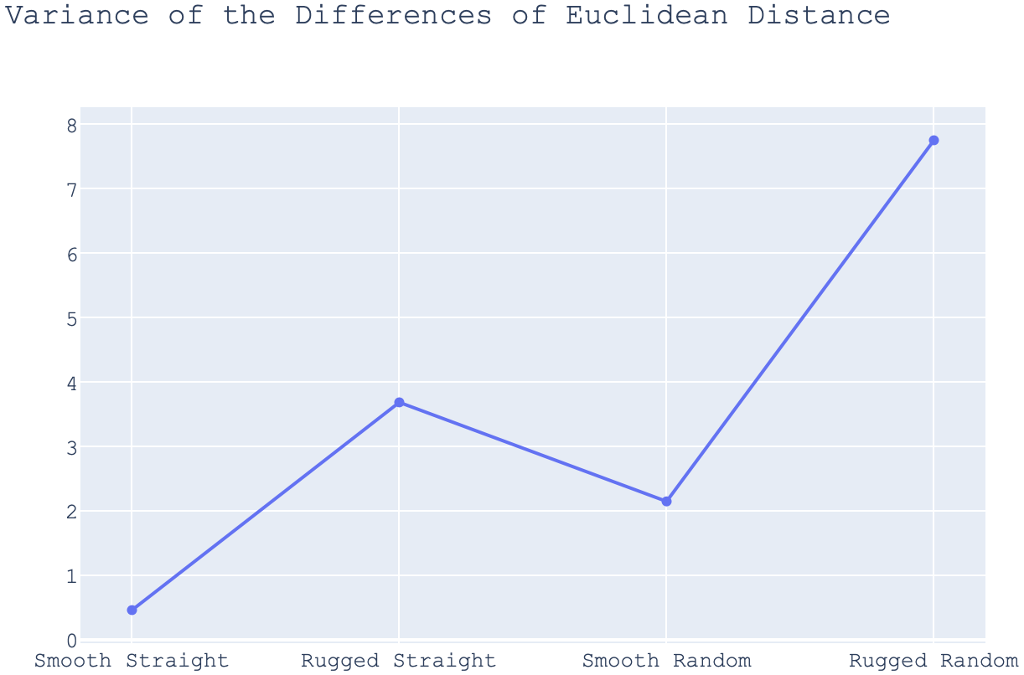
Euclidean Distance: Variance per Dataset
The more the variance, the more the discrepancy exists between the position of AprilTag and the camera.
Notes:
Data based on the previous histogram.

Slide 15
Future Work
Analyze the orientations.
Publish message to avoid getting lost.
Enable fisheye recordings on the tracking camera.
Record the Rviz screen as well when gathering the datasets.

Slide 16
References
Image of the AprilTag: https://berndpfrommer.github.io/tagslam_web/making_tags/
Image of the Intel Realsense Tracking Camera T265: https://www.intelrealsense.com/tracking-camera-t265?utm_source=fb-p&utm_medium=image&utm_campaign=RS_19Q1

